Slide 1
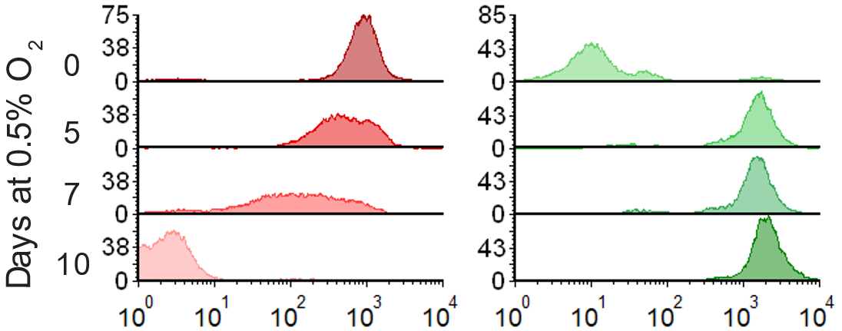
Protein measurement by flow
DsRed Intensity (IU)
GFP Intensity (IU)

Slide 2






Protein measurement by western densitometry analysis
1% O₂
DsRed
0.5 day
2 days
3 days
5 days
GFP
20%
1 day
7 days
HIF-1α
HIF-2α
P4HA1
GFP
DsRed
Actin

Slide 3
Protein measurement by live cell imaging

